Slide 1
Density Estimation I
Statistical Data Analysis, 2023

Slide 2
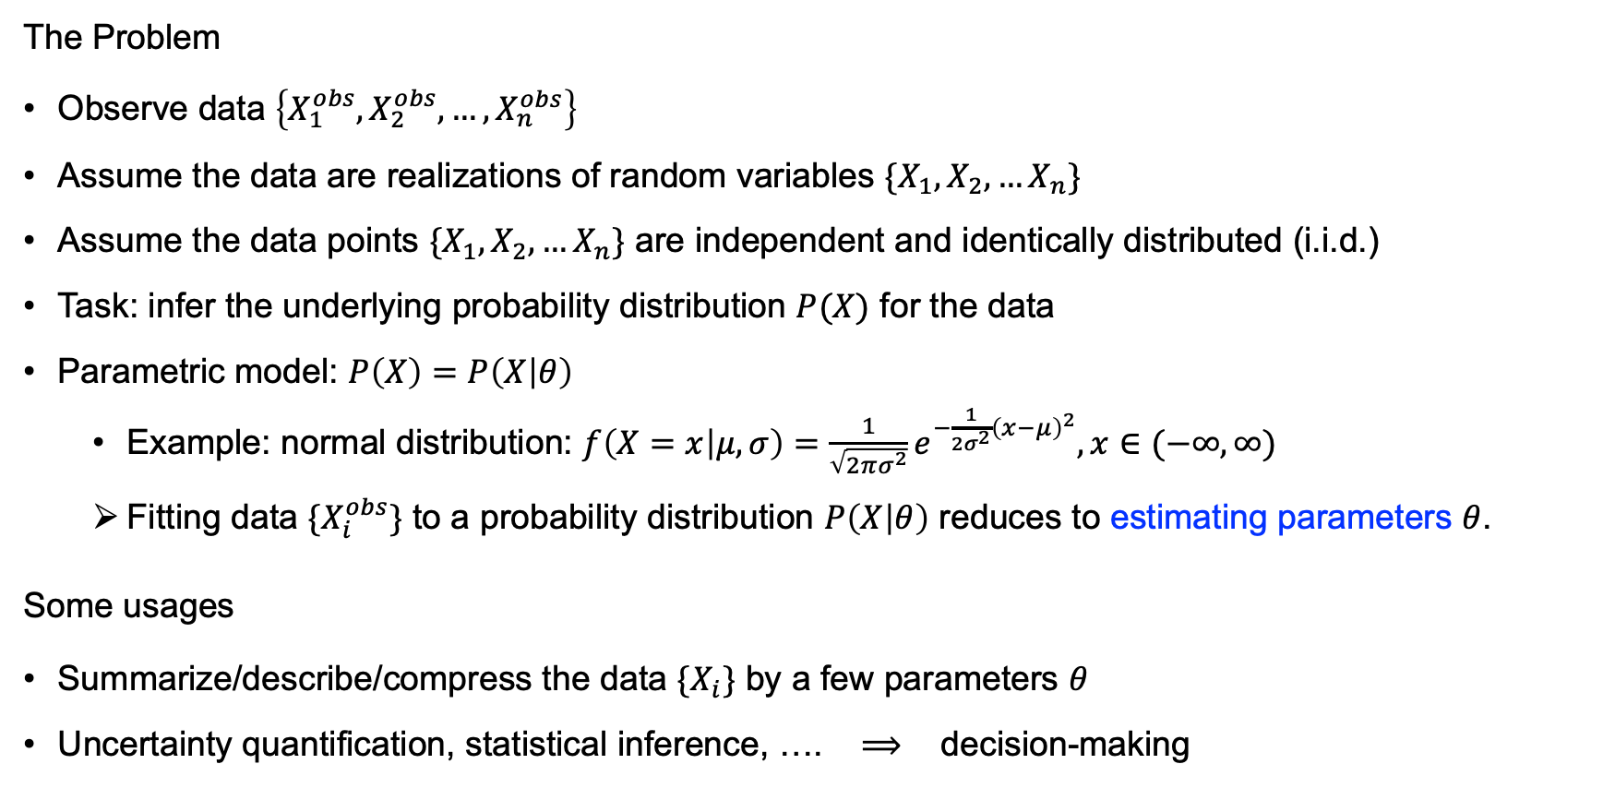
Parametric Model for Estimating Univariate Distribution
The Problem
Observe data $\left\{X_{1}^{obs},X_{2}^{obs},…,X_{n}^{obs}\right\}$
Assume the data are realizations of random variables $\{X_{1},X_{2},…X_{n}\}$
Assume the data points $\{X_{1},X_{2},…X_{n}\}$ are independent and identically distributed (i.i.d.)
Task: infer the underlying probability distribution $P(X)$ for the data
Parametric model: $P\left(X\right)=P\left(X | θ\right)$
Example: normal distribution: $f\left(X=x | μ,σ\right)=\frac{1}{\sqrt{2πσ^{2}}}e^{−\frac{1}{2σ^{2}}{\left(x−μ\right)}^{2}},x∈(−∞,∞)$
Fitting data $\{X_{i}^{obs}\}$ to a probability distribution $P\left(X | θ\right)$ reduces to estimating parameters $θ$.
Some usages
Summarize/describe/compress the data $\{X_{i}\}$ by a few parameters $θ$
Uncertainty quantification, statistical inference, …. $⟹$ decision-making
Notes:
The i.i.d. assumption imposes a restriction on modeling how the data is generated.

Slide 3
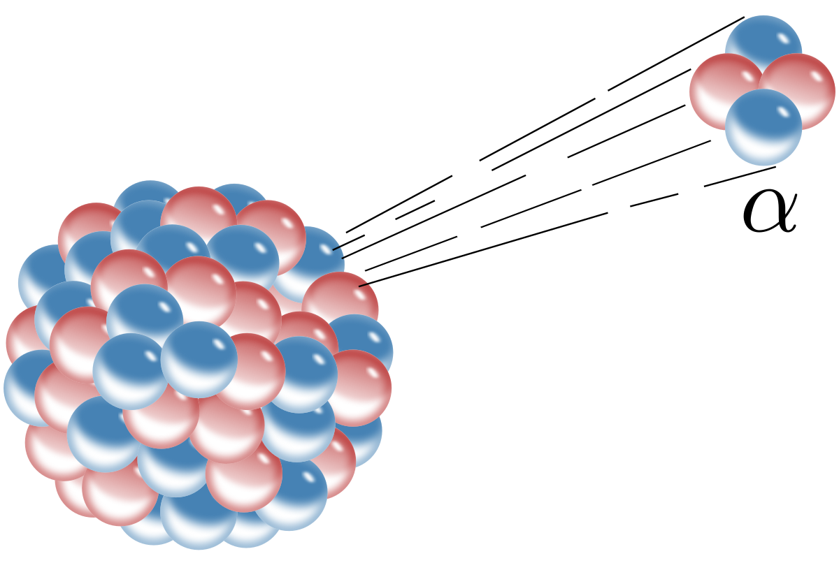
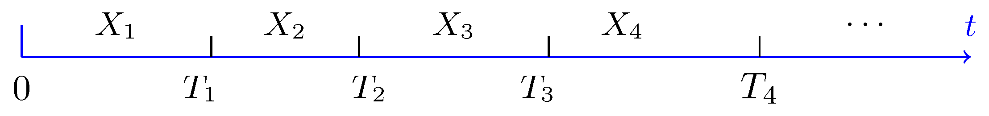
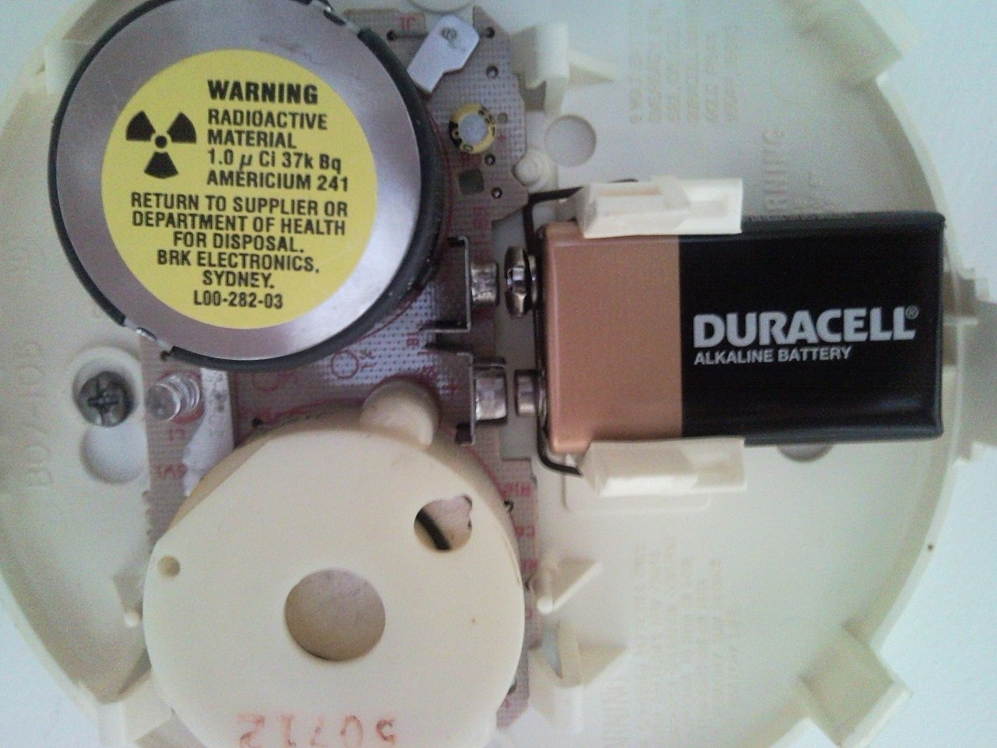
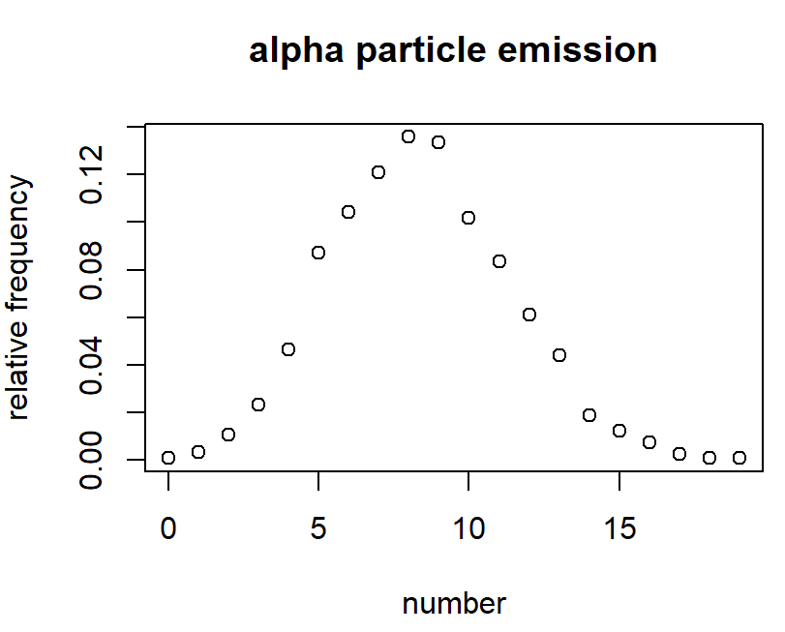
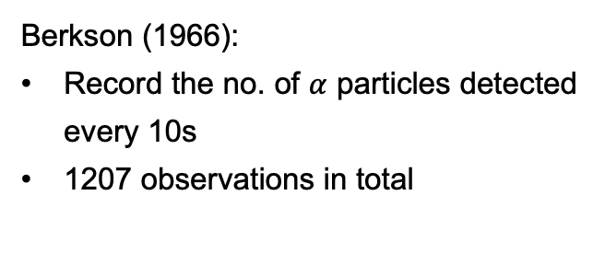
Example: $α$ Particle Emission of Americium(镅)-241
Berkson (1966):
Record the no. of $α$ particles detected every 10s
1207 observations in total
Number 计数 | Frequency 频数 | Relative Frequency 频率
0 | 1 | 0.0008285
1 | 4 | 0.003314002
2 | 13 | 0.010770505
3 | 28 | 0.023198012
4 | 56 | 0.046396023
5 | 105 | 0.086992543
6 | 126 | 0.104391052
7 | 146 | 0.12096106
… | … | …
16 | 9 | 0.007456504
17 | 3 | 0.002485501
18 | 1 | 0.0008285
19 | 1 | 0.0008285
Total | 1207 | 1
Ionization Smoke Detectors

Slide 4
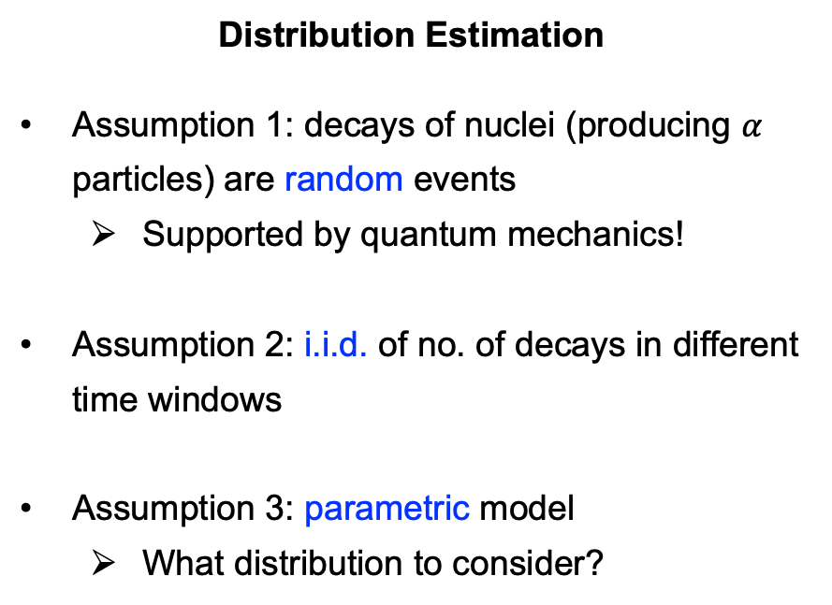
Example: $α$ Particle Emission of Americium(镅)-241
Distribution Estimation
Assumption 1: decays of nuclei (producing $α$ particles) are random events
Supported by quantum mechanics!
Assumption 2: i.i.d. of no. of decays in different time windows
Assumption 3: parametric model
What distribution to consider?

Slide 5
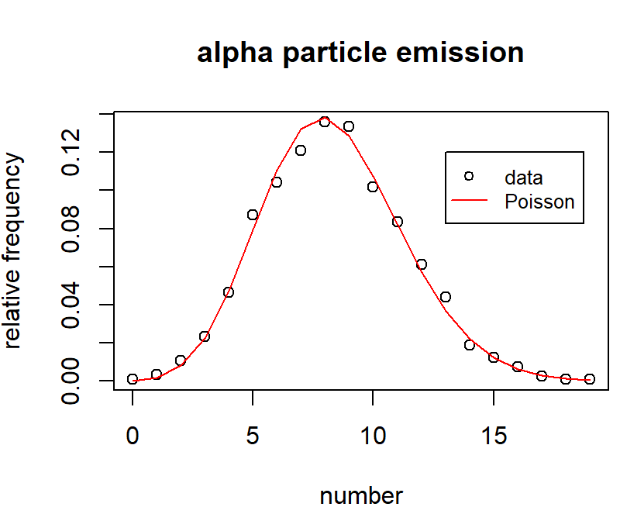
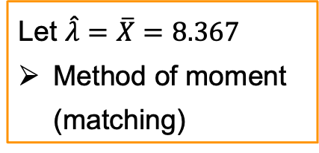
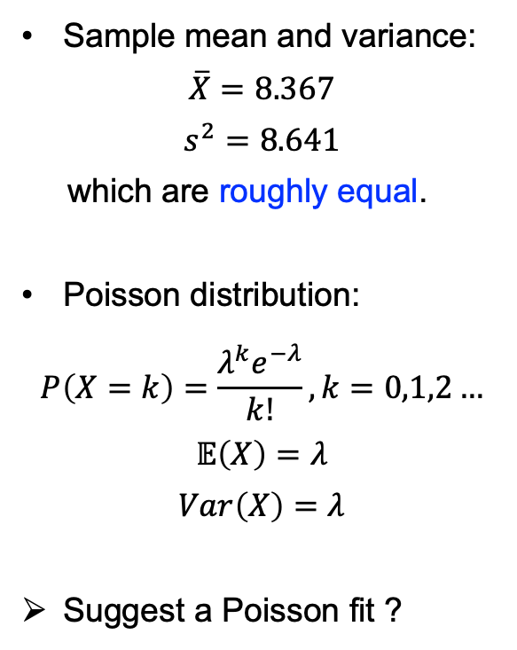
Example: $α$ Particle Emission of Americium(镅)-241
Sample mean and variance:
$$\overline{X}=8.367$$
$$s^{2}=8.641$$
which are roughly equal.
Poisson distribution:
$$P\left(X=k\right)=\frac{λ^{k}e^{−λ}}{k!}, k=0,1,2…$$
$$𝔼\left(X\right)=λ$$
$$Var\left(X\right)=λ$$
Suggest a Poisson fit ?
Let $\hat{λ}=\overline{X}=8.367$
Method of moment (matching)
Notes:
Mean ~ variance

Slide 6
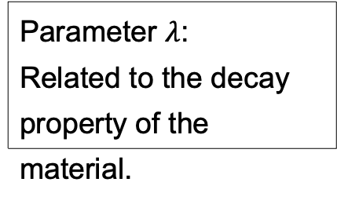
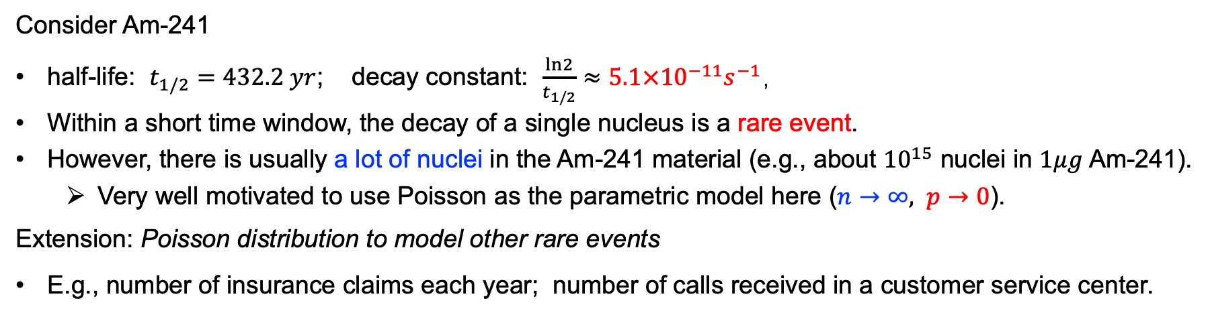
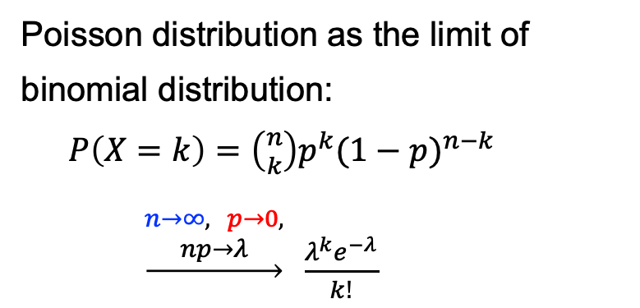
Characteristics of Poisson Distribution
Poisson distribution as the limit of binomial distribution:
$P\left(X=k\right)=\left({n \atop k}\right)p^{k}{(1−p)}^{n−k}$
$\underset{→}{\begin{aligned}n→∞, p→0, \\ np→λ\end{aligned}} \frac{λ^{k}e^{−λ}}{k!}$
Parameter $λ$:
Related to the decay property of the material.
Consider Am-241
half-life: $t_{1/2}=432.2 yr$; decay constant: $\frac{ln2}{t_{1/2}}≈5.1×{10}^{−11}s^{−1}$，
Within a short time window, the decay of a single nucleus is a rare event.
However, there is usually a lot of nuclei in the Am-241 material (e.g., about ${10}^{15}$ nuclei in $1μg$ Am-241).
Very well motivated to use Poisson as the parametric model here ($n→∞, p→0$).
Extension: Poisson distribution to model other rare events
E.g., number of insurance claims each year; number of calls received in a customer service center.

Slide 7
How to estimate parameters (or fit a distribution) in a principled manner?

Slide 8
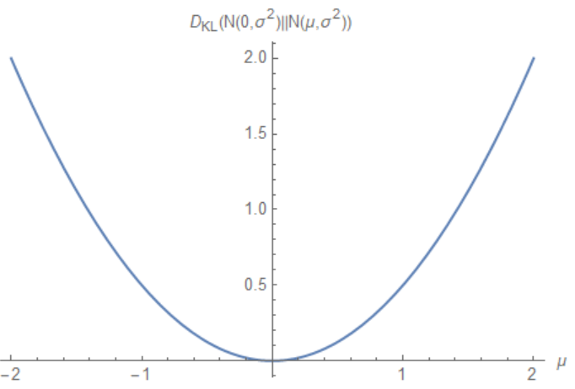
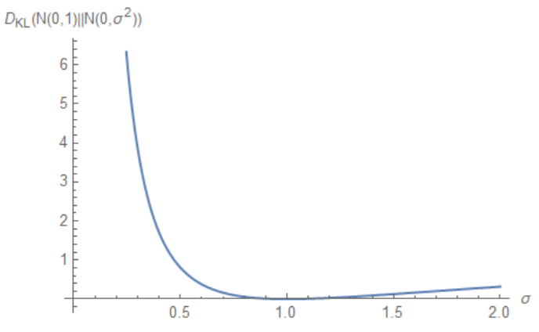
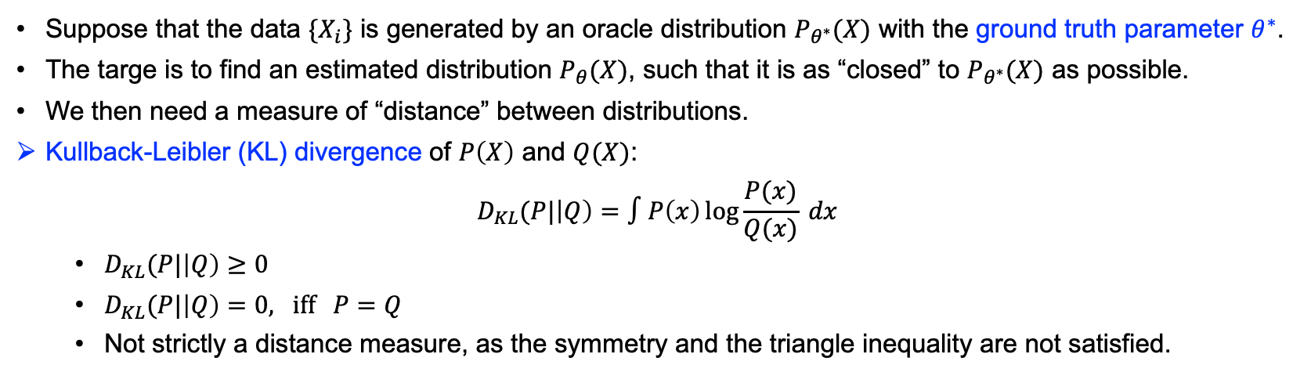


“Distance” Measure
Suppose that the data $\{X_{i}\}$ is generated by an oracle distribution $P_{θ^{∗}}(X)$ with the ground truth parameter $θ^{∗}$.
The targe is to find an estimated distribution $P_{θ}(X)$, such that it is as “closed” to $P_{θ^{∗}}(X)$ as possible.
We then need a measure of “distance” between distributions.
Kullback-Leibler (KL) divergence of $P\left(X\right)$ and $Q(X)$:
$$D_{KL}(P|\left|Q\right)=∫P\left(x\right)\log{\frac{P(x)}{Q(x)}} dx$$
$D_{KL}(P|\left|Q\right)≥0$
$D_{KL}(P|\left|Q\right)=0, iff P=Q$
Not strictly a distance measure, as the symmetry and the triangle inequality are not satisfied.
$$D_{KL}\left(N(0,1)||N(μ,1)\right)$$
$$D_{KL}\left(N(0,1)||N(0,σ^{2})\right)$$
Notes:
KL divergence: rooted in information theory.

Slide 9
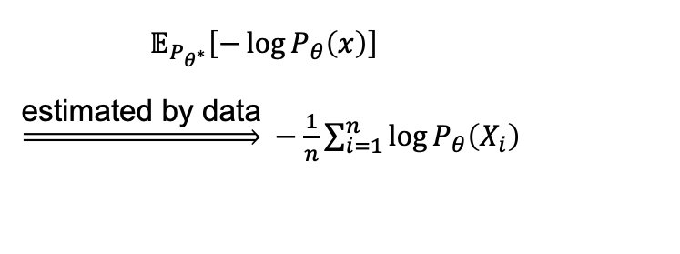
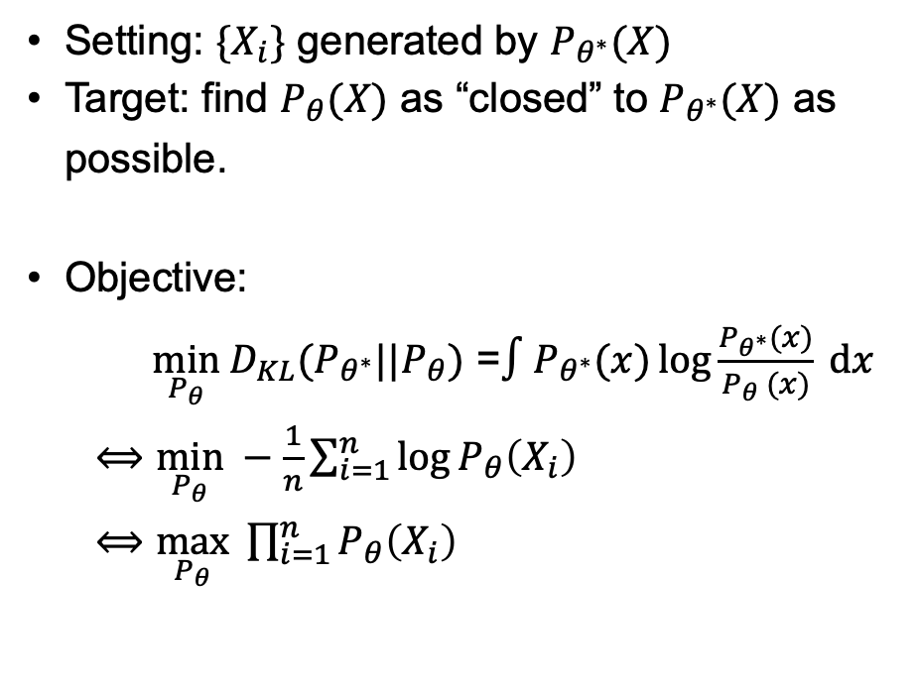

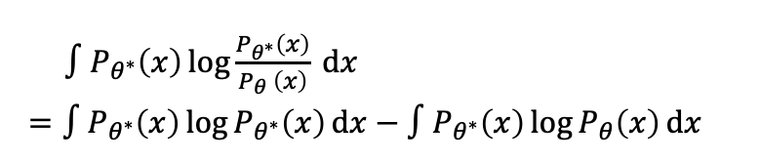
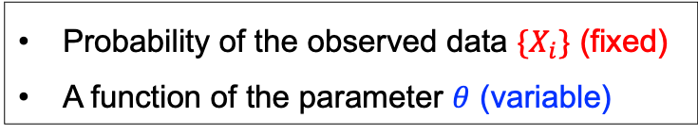
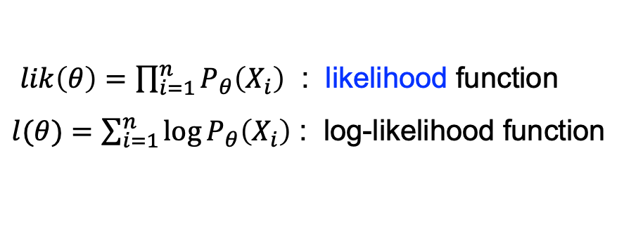
Minimizing the KL Divergence
Setting: $\{X_{i}\}$ generated by $P_{θ^{∗}}(X)$
Target: find $P_{θ}(X)$ as “closed” to $P_{θ^{∗}}(X)$ as possible.
Objective:
$\min_{P_{θ}} D_{KL}(P_{θ^{∗}}||P_{θ})$ =$∫P_{θ^{∗}}(x)\log{\frac{P_{θ^{∗}}(x)}{P_{θ} (x)}} dx$
$⟺\min_{P_{θ}} −\frac{1}{n}\sum_{i=1}^{n}{\log{P_{θ}\left(X_{i}\right)}}$
$⟺\max_{P_{θ}} \prod_{i=1}^{n}{P_{θ}\left(X_{i}\right)}$
$∫P_{θ^{∗}}\left(x\right)\log{\frac{P_{θ^{∗}}\left(x\right)}{P_{θ} \left(x\right)}} dx$
$=∫P_{θ^{∗}}\left(x\right)\log{P_{θ^{∗}}\left(x\right)}dx−∫P_{θ^{∗}}\left(x\right)\log{P_{θ}\left(x\right)}dx$
Constant w.r.t. $θ$
Cross entropy
$𝔼_{P_{θ^{∗}}}\left[−\log{P_{θ}\left(x\right)}\right]$
$\underset{⇒}{\text{estimated} \text{by} \text{data}} −\frac{1}{n}\sum_{i=1}^{n}{\log{P_{θ}\left(X_{i}\right)}}$
$lik\left(θ\right)=\prod_{i=1}^{n}{P_{θ}\left(X_{i}\right)}$ : likelihood function
$l(θ)=\sum_{i=1}^{n}{\log{P_{θ}\left(X_{i}\right)}}$ : log-likelihood function
Probability of the observed data $\{X_{i}\}$ (fixed)
A function of the parameter $θ$ (variable)

Slide 10
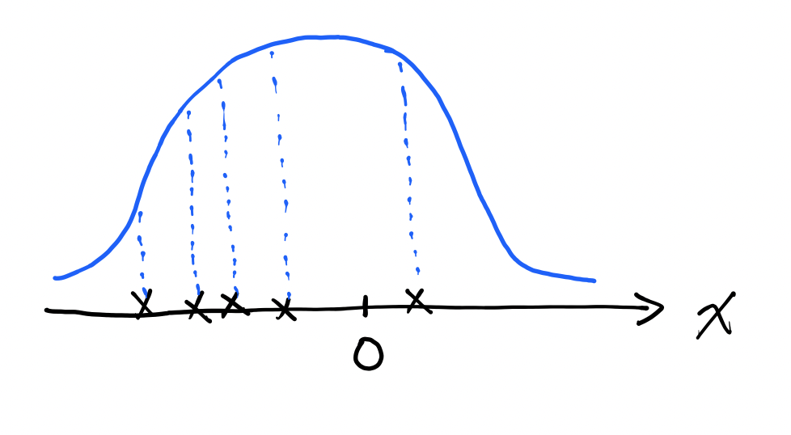
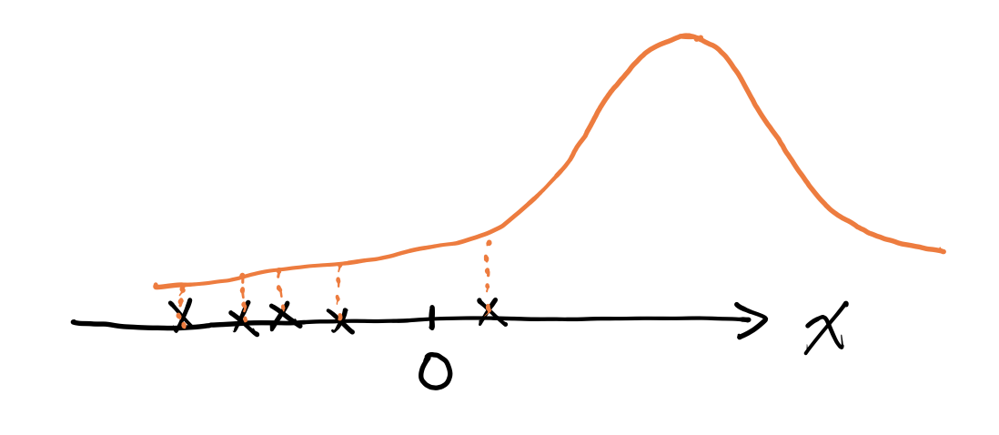

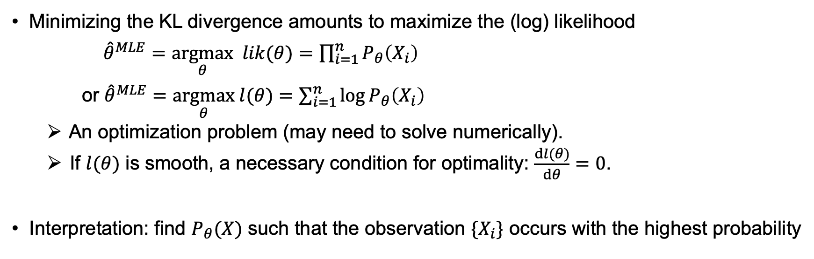


Maximum Likelihood Estimation (MLE)
Minimizing the KL divergence amounts to maximize the (log) likelihood
${\hat{θ}}^{MLE}=\underset{θ}{argmax} lik(θ)=\prod_{i=1}^{n}{P_{θ}\left(X_{i}\right)}$
or ${\hat{θ}}^{MLE}=\underset{θ}{argmax} l(θ)=\sum_{i=1}^{n}{\log{P_{θ}\left(X_{i}\right)}}$
An optimization problem (may need to solve numerically).
If $l(θ)$ is smooth, a necessary condition for optimality: $\frac{dl(θ)}{dθ}=0$.
Interpretation: find $P_{θ}(X)$ such that the observation $\{X_{i}\}$ occurs with the highest probability
$$P_{θ_{1}}(X)$$
$$P_{θ_{2}}(X)$$
Notes:
Why not start from the intuitive probabilistic interpretation?
KL -> easy to extend to other framework. (optimization: change another distance)

Slide 11

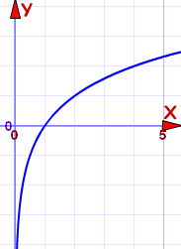

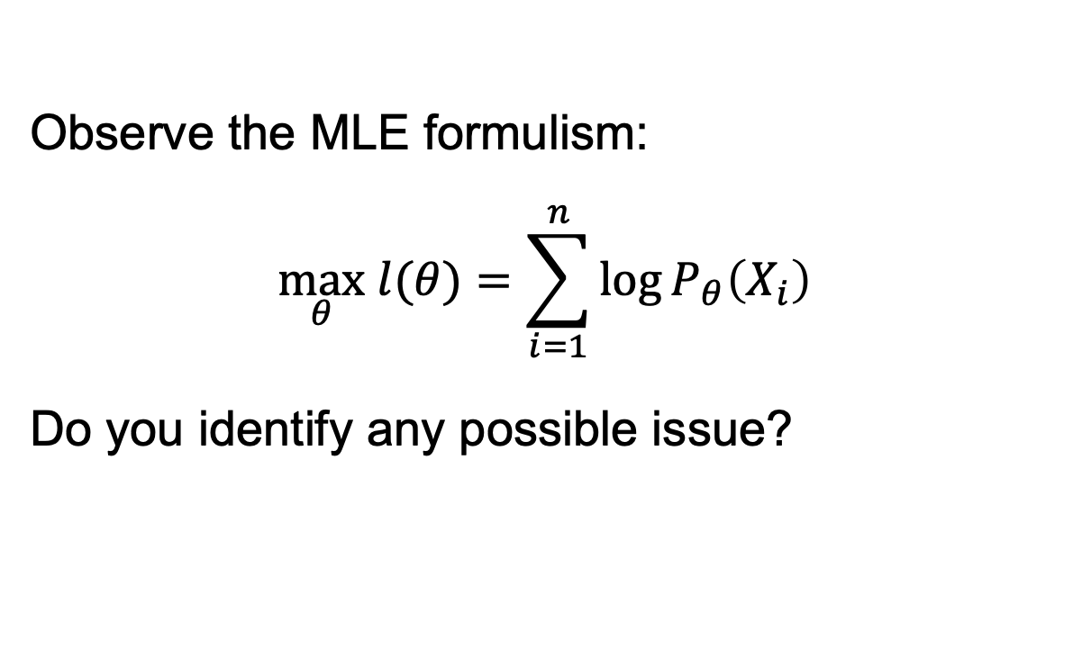
主观题
10分
Observe the MLE formulism:
$$\max_{θ} l(θ)=\sum_{i=1}^{n}{\log{P_{θ}\left(X_{i}\right)}}$$
Do you identify any possible issue?
$$\log{(x)}$$
正常使用主观题需2.0以上版本雨课堂
作答
Notes:
Log(x) not defined at x = 0.
i) Pure initialization of parameters can return an error, due to log(0).
ii) Maybe problematic when the density of the model does not cover the whole space.

Slide 12
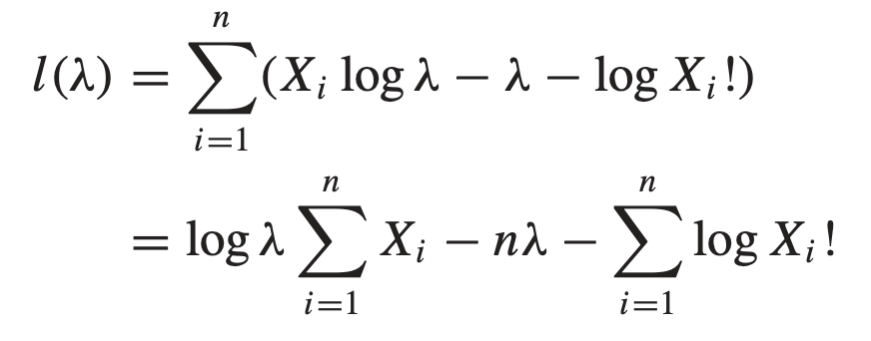
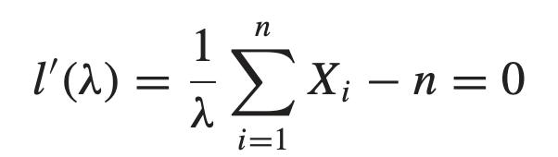

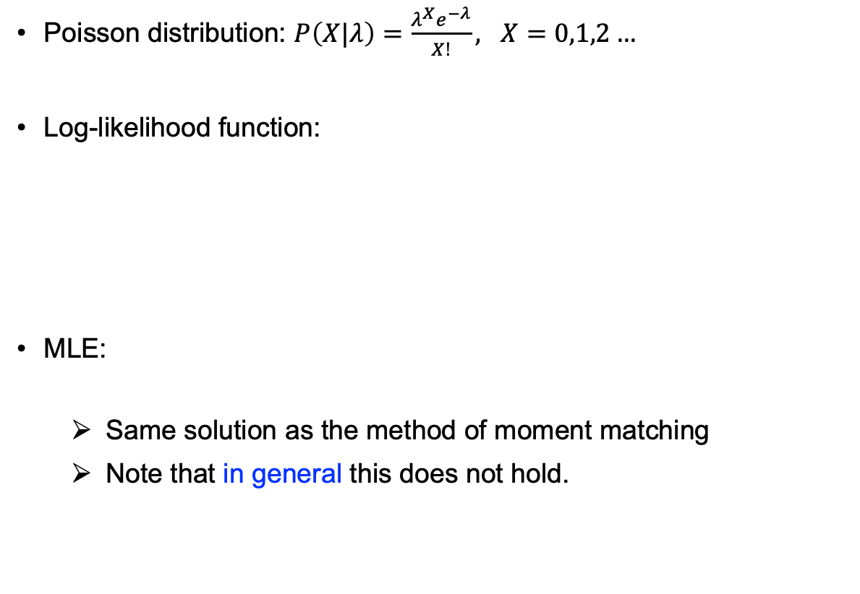
Example: $α$ Particle Emission Data
Poisson distribution: $P\left(X|λ\right)=\frac{λ^{X}e^{−λ}}{X!}, X=0,1,2…$
Log-likelihood function:
MLE:
Same solution as the method of moment matching
Note that in general this does not hold.
Number 计数 | Frequency 频数 | Relative Frequency 频率
0 | 1 | 0.0008285
1 | 4 | 0.003314002
2 | 13 | 0.010770505
3 | 28 | 0.023198012
4 | 56 | 0.046396023
5 | 105 | 0.086992543
6 | 126 | 0.104391052
7 | 146 | 0.12096106
… | … | …
16 | 9 | 0.007456504
17 | 3 | 0.002485501
18 | 1 | 0.0008285
19 | 1 | 0.0008285
Total | 1207 | 1

Slide 13
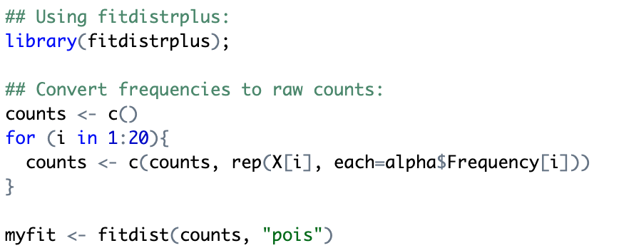

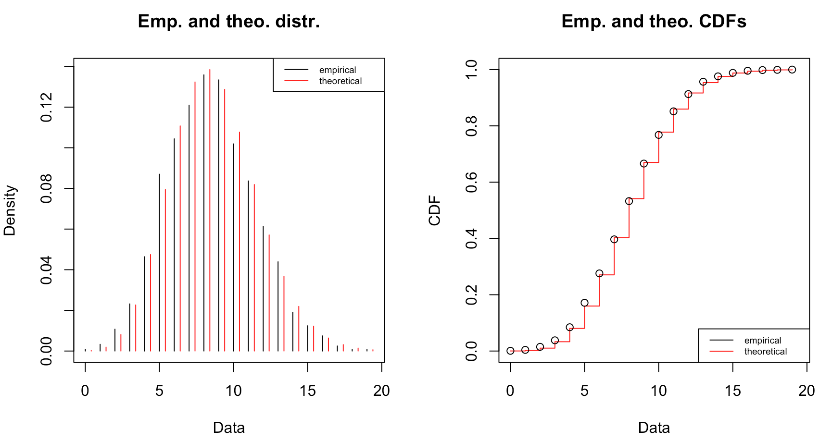
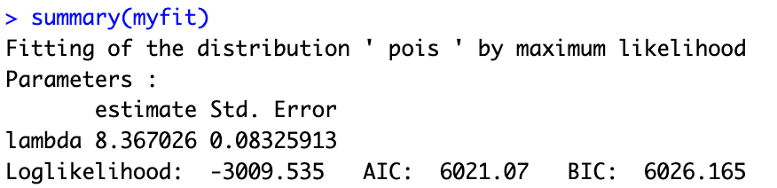
Fitting by fitdistrplus in R
Data: alpha
fitdistrplus is a very useful R package for fitting univariate distributions.
Convenient for visualization and doing statistical inference.
X
Frequency
Number 计数 | Frequency 频数 | Relative Frequency 频率
0 | 1 | 0.0008285
1 | 4 | 0.003314002
2 | 13 | 0.010770505
3 | 28 | 0.023198012
… | … | …

Slide 14
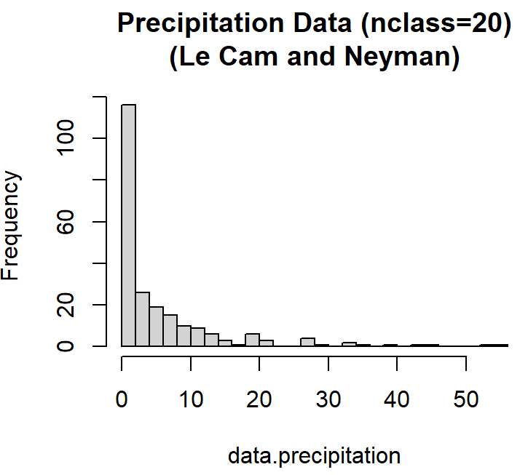
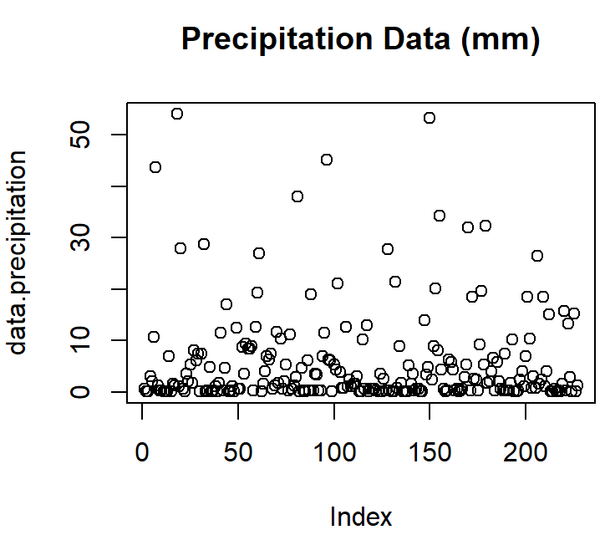
Example: Precipitation (降雨量) Data
Amounts of precipitation during 227 storms in Illinois from 1960 to 1964 [Le Cam and Neyman 1967]
mm
Q: what distribution should we use to fit this data?
Unlike particle decay in physics, we don’t have a simple theory for modeling weather…
Nevertheless, we can still empirically choose a distribution, as long as it fits the data well.

Slide 15
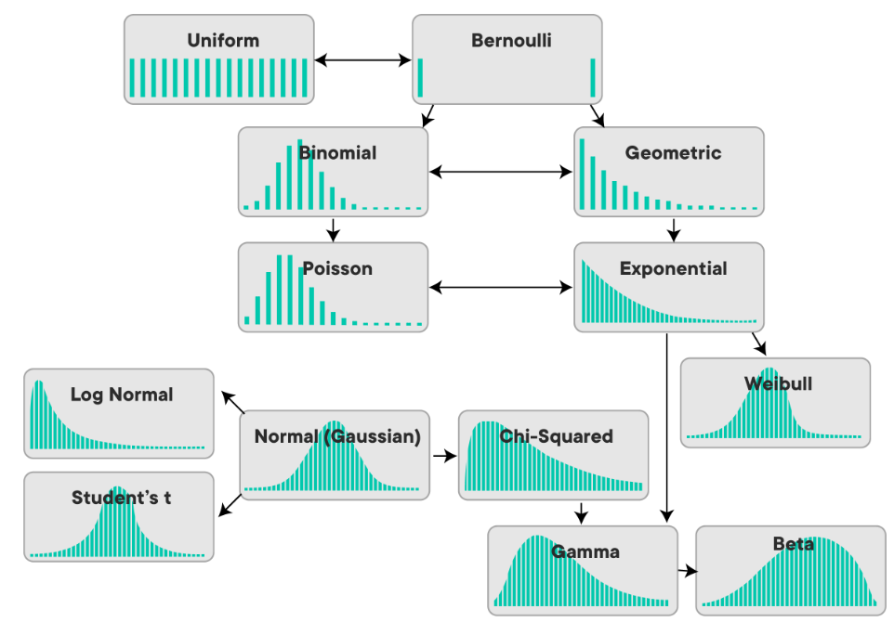
Choosing a Distribution
mm
Q: what distribution should we use to fit this data?

Slide 16
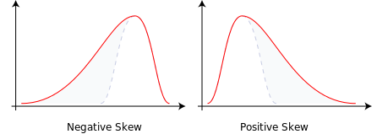
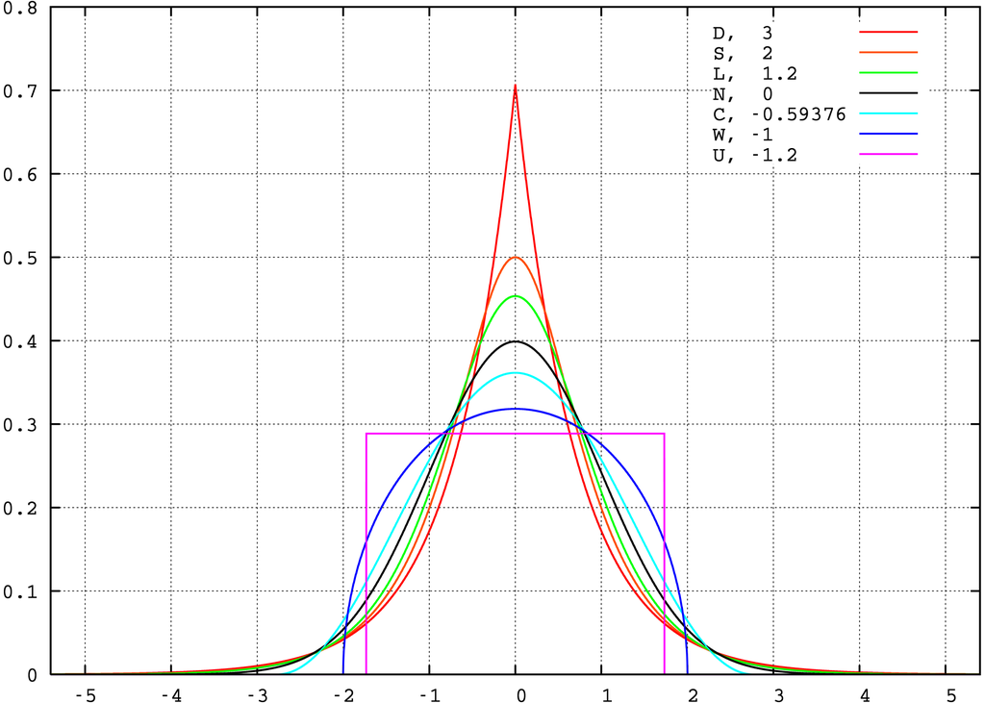
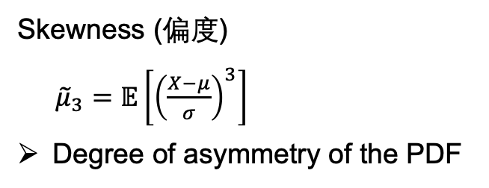
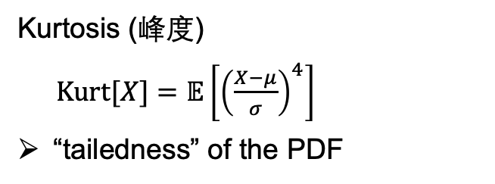
Choosing a Continuous Distribution
Two descriptors of the shape of a probability density function (PDF)
Skewness (偏度)
${\tilde{μ}}_{3}=𝔼\left[{\left(\frac{X−μ}{σ}\right)}^{3}\right]$
Degree of asymmetry of the PDF
Kurtosis (峰度)
$Kurt[X]=𝔼\left[{\left(\frac{X−μ}{σ}\right)}^{4}\right]$
“tailedness” of the PDF
Notes:
tall, heavy-tailed => high kurtosis

Slide 17


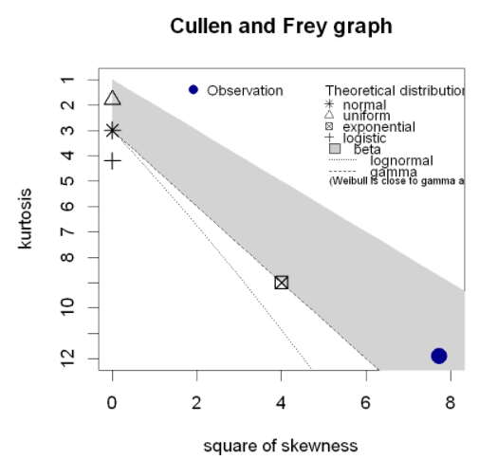
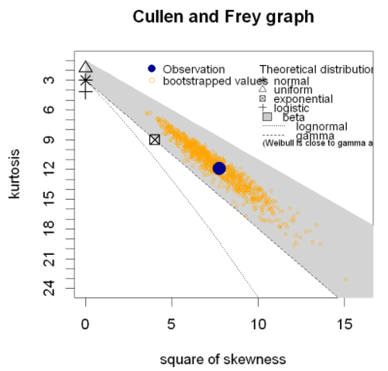
Choosing a Continuous Distribution by fitdistrplus
Skewness-kurtosis plot (Cullen and Frey, 1999) by fitdistrplus::descdist()
mm
Remark:
The sample estimations of high-order moments such as skewness and kurtosis are not very robust.
Use as a reference only.

Slide 18
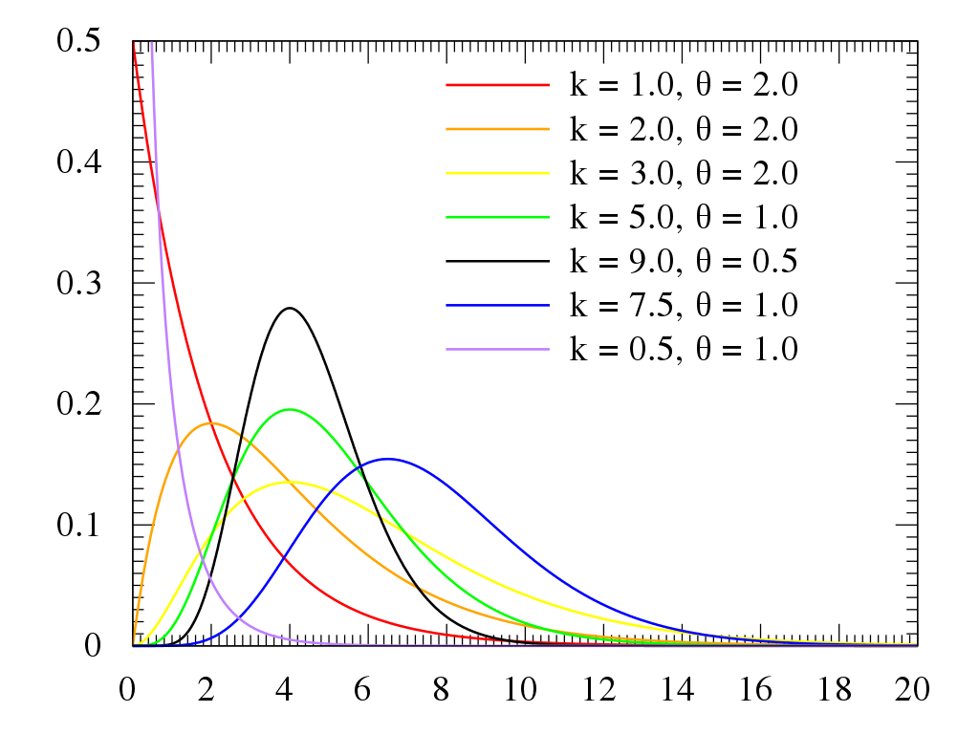
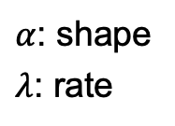
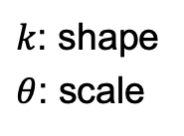
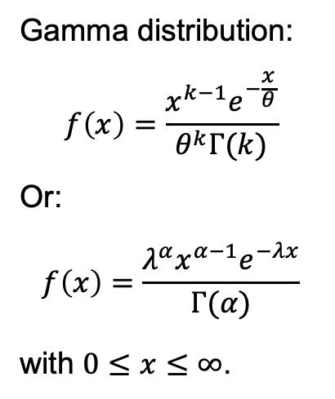
Gamma Distribution for the Precipitation Data
Gamma distribution:
$$f\left(x\right)=\frac{x^{k−1}e^{−\frac{x}{θ}}}{θ^{k}Γ(k)}$$
Or:
$$f\left(x\right)=\frac{λ^{α}x^{α−1}e^{−λx}}{Γ(α)}$$
with $0≤x≤∞$.
$k$: shape
$θ$: scale
$α$: shape
$λ$: rate
mm
The family of gamma distributions provides a flexible set of densities for nonnegative random variables.

Slide 19

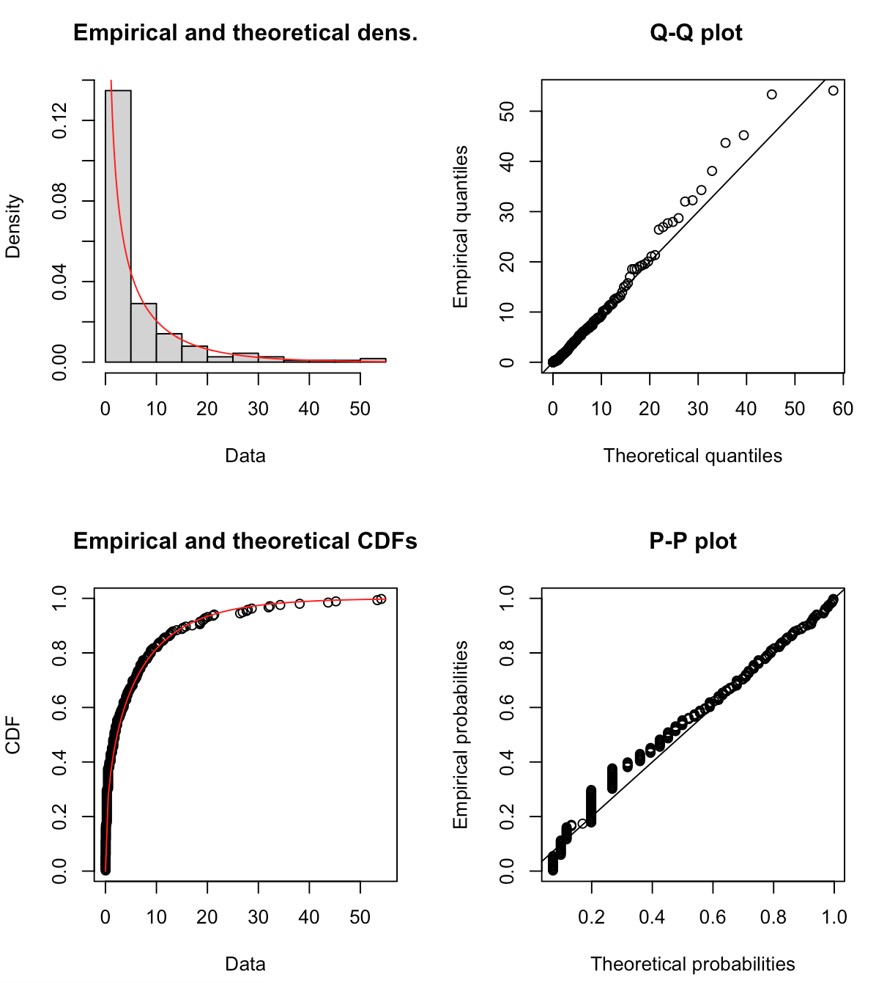
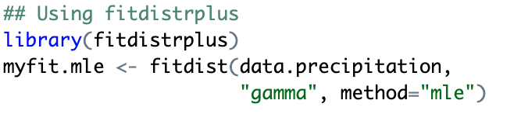
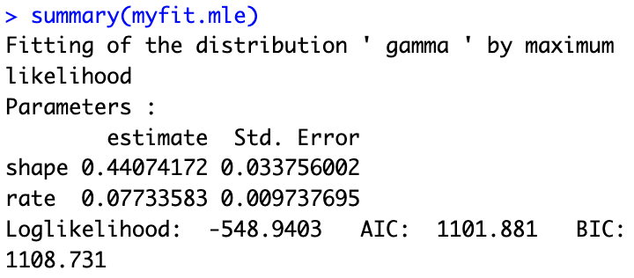
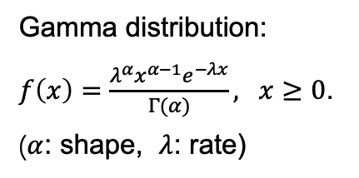
Gamma Distribution for the Precipitation Data
Gamma distribution:
$f\left(x\right)=\frac{λ^{α}x^{α−1}e^{−λx}}{Γ(α)}, x≥0$.
($α$: shape, $λ$: rate)
mm
?

Slide 20
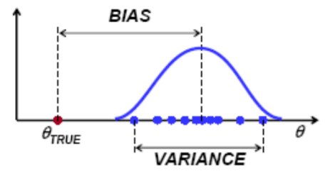




Performance of the Estimate
How do we assess whether the fitting is good or not?
Generally we can use the KL-divergence $D_{KL}(P^{true}\left(X\right) || P^{estimated}(X))$ or its relatives, e.g., the (log) likelihood
We will see this when we come to hypothesis testing.
A natural measure for parametric model: mean squared error (MSE) $MSE\left(\hat{θ}\right)=𝔼{\left(\hat{θ}−θ^{∗}\right)}^{2}$
where $θ_{0}$ is the true parameter.
It admits a bias-variance decomposition: $MSE\left(\hat{θ}\right)={\left(𝔼\left(\hat{θ}\right)−θ^{∗}\right)}^{2}+Var(\hat{θ})$
$$\hat{θ}=\hat{θ}(X_{1},…, X_{n})$$
A fixed number for given data $\{X_{i}\}$
A random variable if data is not specified (e.g., before experiment)
Hint of proof:
Consider
$$𝔼{\left[\hat{θ}−𝔼\left(\hat{θ}\right)+𝔼\left(\hat{θ}\right)−θ^{∗}\right]}^{2}$$
Do not be confused with variance of the random variable $X$:
$Var_{P_{θ}}(X)$.

Slide 21



Performance of the Estimate
$MSE\left(\hat{θ}\right)={\left(𝔼\left(\hat{θ}\right)−θ^{∗}\right)}^{2}+Var\left(\hat{θ}\right)$ (Important!)
Bias: $𝔼\left(\hat{θ}\right)−θ^{∗}$
We certainly want unbiased estimators with $𝔼\left(\hat{θ}\right)=θ^{∗}$.
Don’t we?
Variance: $Var\left(\hat{θ}\right)$
Standard error: $SE\left(\hat{θ}\right)=\sqrt{Var\left(\hat{θ}\right)}$
Variability of your estimate when estimate $θ$ on different samples.
Generally $SE\left(\hat{θ}\right)∝1/\sqrt{n}$ ($n$: sample size)
Cramér-Rao Inequality
Lower bound for unbiased estimator (under some smoothness condition): $Var\left(\hat{θ}\right)≥\frac{1}{nI\left(θ^{∗}\right)}$
Fisher information:
$I\left(θ\right)=E_{X}{\left(\frac{∂}{∂θ}\ln{P_{θ}\left(X\right)}\right)}^{2}=−E_{X}\left(\frac{∂^{2}}{∂θ^{2}}\ln{P_{θ}\left(X\right)}\right)$

Slide 22



Performance of MLE
In the large sample size limit $n→∞$,
$$P\left({\hat{θ}}^{MLE}\right)\underset{→}{ n→∞} N\left(θ^{∗}, \frac{1}{nI\left(θ^{∗}\right)}\right).$$
MLE is asymptotically unbiased.
May be biased when sample size is finite.
MLE is asymptotic efficient.
$Var\left({\hat{θ}}^{MLE}\right)$ approaching the lower bound $Var(\hat{θ})$ in CR.
Achieving both low bias and low variance!
Cramér-Rao inequality for unbiased estimator:
$Var\left(\hat{θ}\right)≥\frac{1}{nI\left(θ^{∗}\right)}$
“If Fisher had lived in the era of ‘apps,’ maximum likelihood estimation might have made him a billionaire. Arguably the twentieth century’s most influential piece of applied mathematics, maximum likelihood continues to be a prime method of choice in the statistician’s toolkit…”
Ronald Fisher
(1890 – 1962)
- Chap 7, CASI

Slide 23






A Comparison of Variability
Fitting Gamma distribution to precipitation data
$$f\left(x\right)=\frac{λ^{α}x^{α−1}e^{−λx}}{Γ(α)}, x≥0$$
Comparing variability of the method of moment (MOM) and maximum likelihood (MLE)
${\hat{θ}}^{MLE}=\underset{θ}{argmax} l(θ)=\sum_{i=1}^{n}{\log{P_{θ}\left(X_{i}\right)}}$
Comment:
MLE makes good use of the fine-grained information of the distribution and the sample.
MOM firstly compresses the information of the sample into moments, which are then used to estimate the parameter.

Slide 24


Dominance of MLE over Other Estimators?
$$P\left({\hat{θ}}^{MLE}\right)\underset{→}{ n→∞} N\left(θ^{∗}, \frac{1}{nI\left(θ^{∗}\right)}\right).$$
It seems that the ultimately desirable estimator has been found.
Q: Shall we stick to use MLE in any cases when there is a need to estimate parameters of a distribution?
We will come to this question a few times in this course.
Cramér-Rao inequality for unbiased estimator:
$Var\left(\hat{θ}\right)≥\frac{1}{nI\left(θ^{∗}\right)}$

